Slide 1
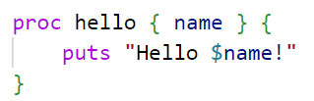

TCL
Tool Command Language
הכל בסייעתא דשמיא
By David Berger and Yehuda Shani
Lev Academic Center 5783/2023

Slide 2
What is TCL?
Created (1988) as a Powerful and flexible Scripting Language
Qualities: High-level, All-purpose, Interpreted, Dynamically Typed, Simple Syntax, Portable
Use: Scripting, Automation, Embedded into other applications (Especially EDA - Electronic Design Automation)

Slide 3
Other Language: |  | TCL
Python | Large Community | Small Community
Javascript | Supports asynchronous programming, event-driven development | Primarily single threaded
 | Ideal for frontend | Limited front end capabilities
Java | Compiled, Statically typed | Interpreter, hard to detect bugs
 | Fully supports OOP | Limited OOP, more procedural in nature
C/C++ | Manual memory management | Automatic memory management
Bash scripting | Provides many cmd-line utilities, system tools, integration with UNIX | Contains less tools, provides many elements that Bash does not provide

Slide 4
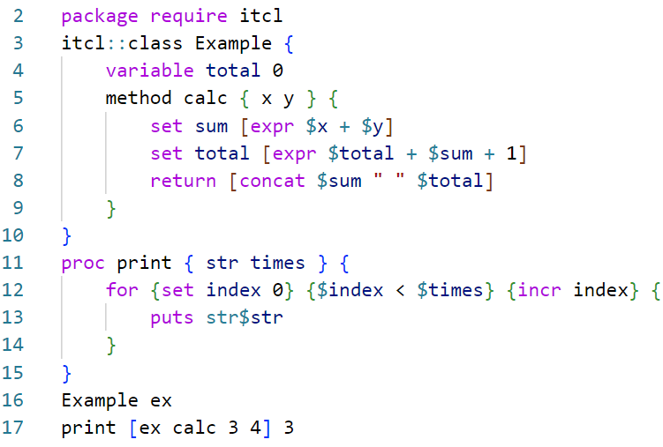
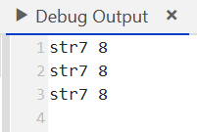
A General Example
# NOTICE:
# only one constructor
# a "proc" can exist w/out a class
# params are just sent falanga
# sensitive to " " "\n"
# line 6 - expr
# line 8 vs 13

Slide 5
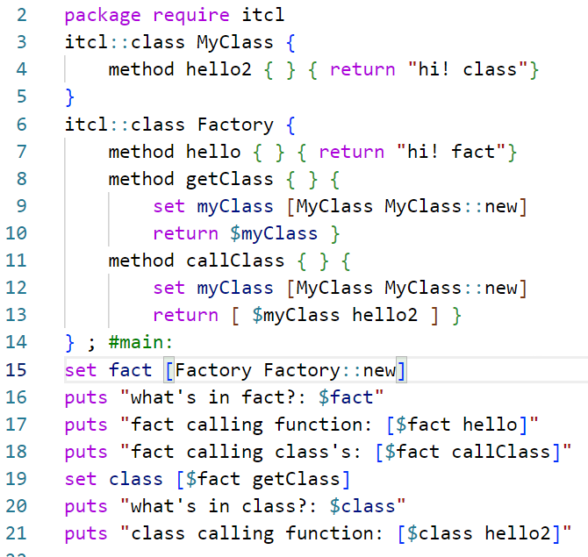
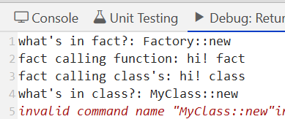
Limit to OOP: Returning Strings only..
# Notice:
# Main has an obj Factory, can access functions
# Factory can return results from it's inner class
# but factory CANT return a reference!!
to it's innner class... interpreted as a string
(also, can only have 1 ctor…)

Slide 6
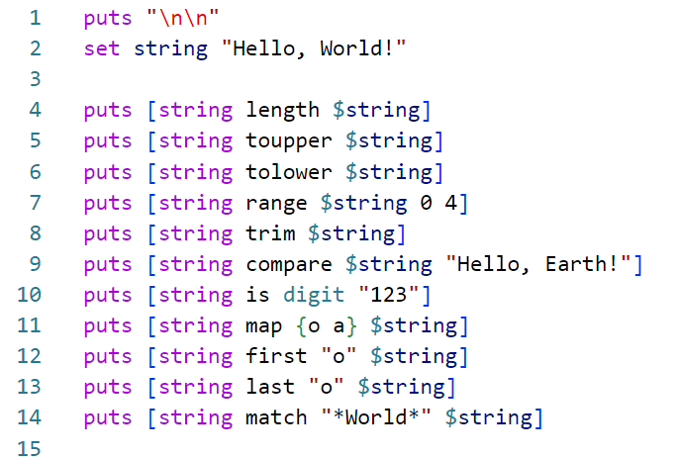
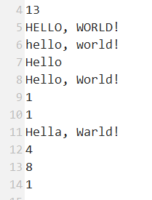
But Many Built in String Functions
# And many more..

Slide 7
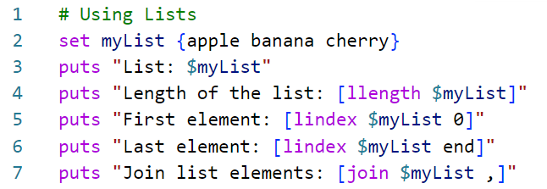
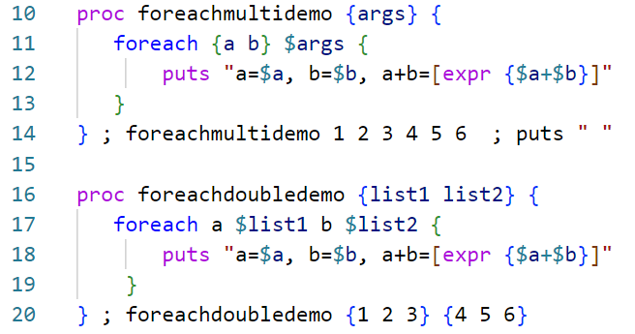
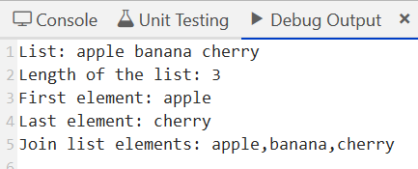
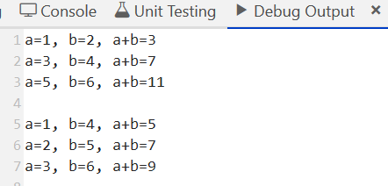
Data Structures - Lists
# notice: very intuitive commands
# but sophisticated functionality

Slide 8
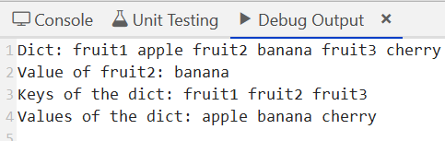
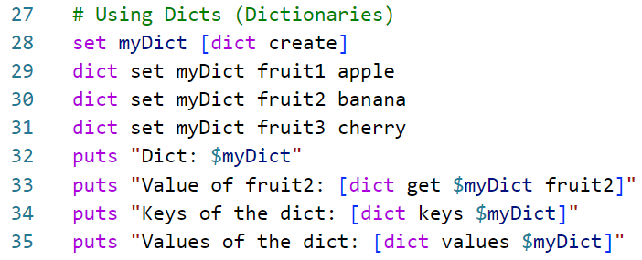
Data Structures - Dict
# There are also Arrays… but hard to do more than that

Slide 9
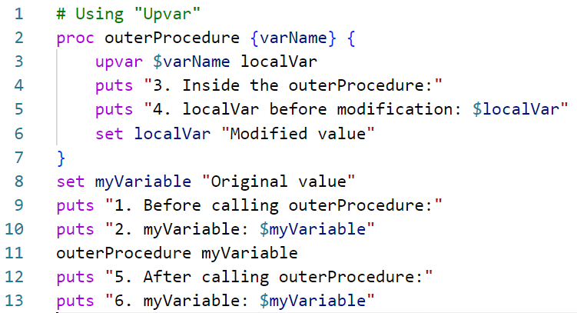
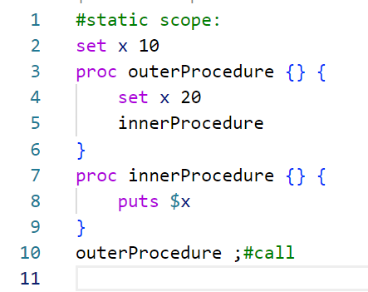
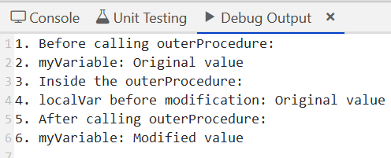

Scope: Usually Static, but…

Slide 10
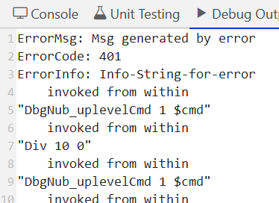
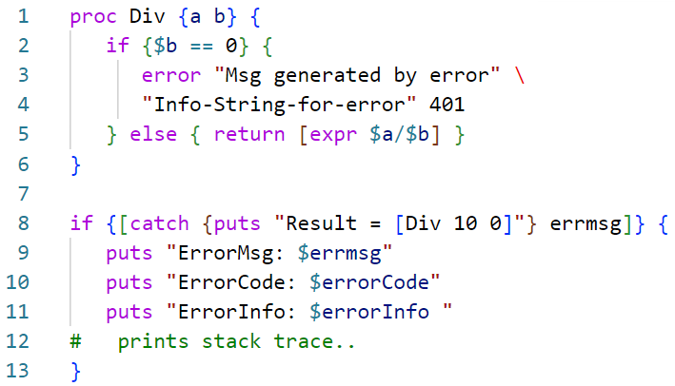
Error Messages
# But a bit cumbersome!

Slide 11
A Few Points we didn’t touch:
# Abstraction - TCL intended for procedural abstraction and not complex data structures…
# Threads - TCL supports multithreading, but it is very uncommon (for obvious reasons)
# Dynamic Memory - dealt with by Garbage Collector
# Very Orthogonal - (ability to build something from given pieces) : TCL provides few core commands, but they are very useful and intependent
# Portable - Yes! Bintended to be embedded… does not rely on huge libraries or OS specific functionalities (unlike Swift, Powershell, etc)
# Style - intended for Procedural, Imperative, Step-by-Step and task focused ... Limited Support for OOD. Almost never used for Parrallel and Complex Multithreading.

